Slide 1

呵呵
CS513 Final Project
Analysis and classification of London bike sharing
Group members: Nianqi Tian, Jiaqian Zhang, Ruohuan Xu, Yuting Shao, Zhili Yu

Slide 2

Table of Content
Data Present
Data Clean
Models
Conclusion
STEVENS INSTITUTE OF TECHNOLOGY

Slide 3
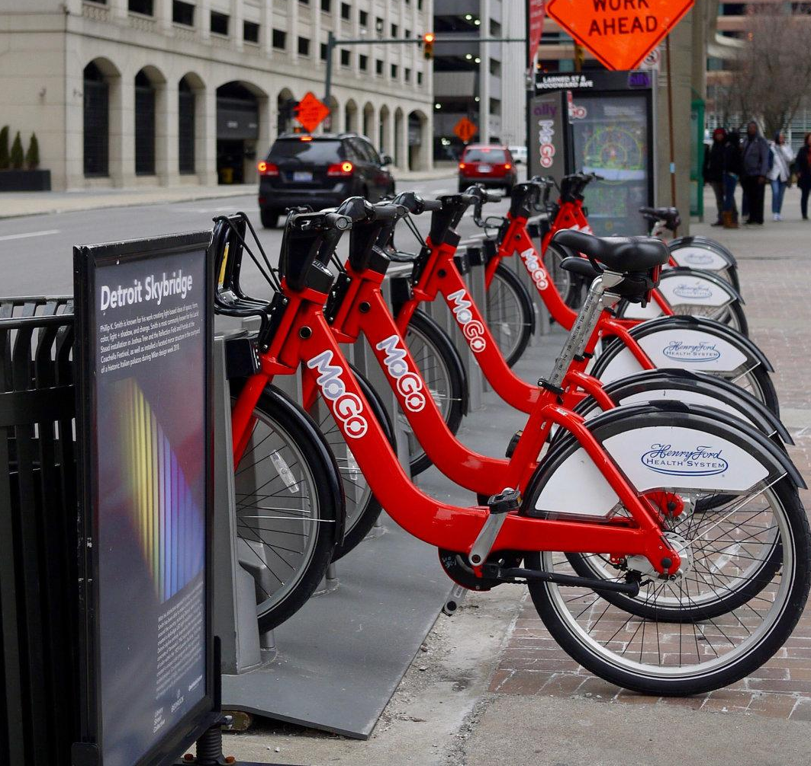
DataSource
Historical data for bike sharing in London ‘Powered by TfL Open Data’
From KAGGLE
https://www.kaggle.com/hmavrodiev/london-bike-sharing-dataset
STEVENS INSTITUTE OF TECHNOLOGY

Slide 4
Purpose
Predict the future bike shares
Find the important variables
STEVENS INSTITUTE OF TECHNOLOGY

Slide 5
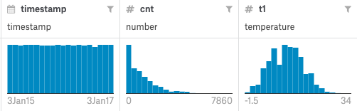
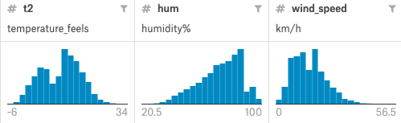
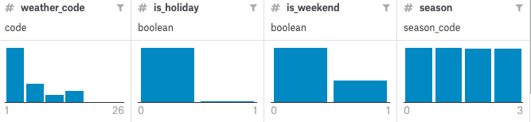
Data present
STEVENS INSTITUTE OF TECHNOLOGY

Slide 6
Data present
STEVENS INSTITUTE OF TECHNOLOGY

Slide 7
Data Preprocessing
STEVENS INSTITUTE OF TECHNOLOGY

Slide 8
Original Data Attribute
1.Timestamp
2. t1 (real temperature in C)
3. t2 (temperature in C "feels like)
4. Hum (humidity in percentage)
5. wind_speed
6. weather_code
7. is_holiday
8. is_weekend
9. Season
STEVENS INSTITUTE OF TECHNOLOGY

Slide 9
After preprocessing
1. t1
2. t2
3. Hum
4. wind_speed 5. is_holiday
6. is_weekend
7. is_cloudy 8. is_raining
9. is_snowing
10. is_spring
11. is_summer
12. is_fall
13. is_winter 14. is_night
15. hour
STEVENS INSTITUTE OF TECHNOLOGY

Slide 10
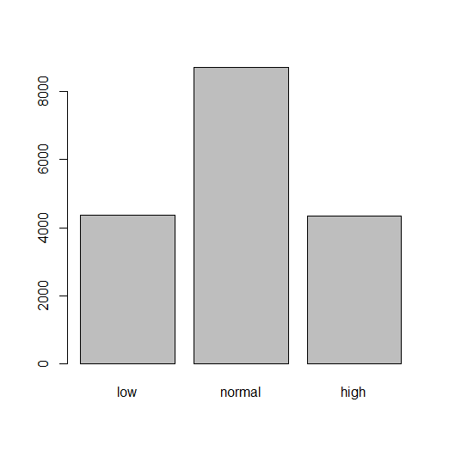
Classify CNT attribute
judge_level <- function(x)
{
Qu <- quantile(x)
First_quantile <- Qu[2]
Median <- Qu[3]
Thrid_quantile <- Qu[4]
for(i in 1:NROW(x))
{
if(x[i] <= First_quantile)
x[i] = 1
else if(First_quantile < x[i] & x[i] <= Thrid_quantile)
x[i] = 2
else
x[i] = 3
}
return(x)
}
STEVENS INSTITUTE OF TECHNOLOGY

Slide 11
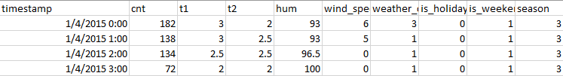
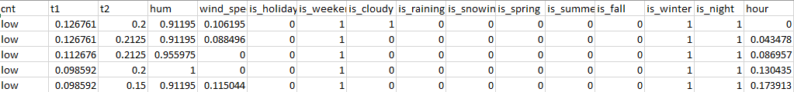
STEVENS INSTITUTE OF TECHNOLOGY

Slide 12
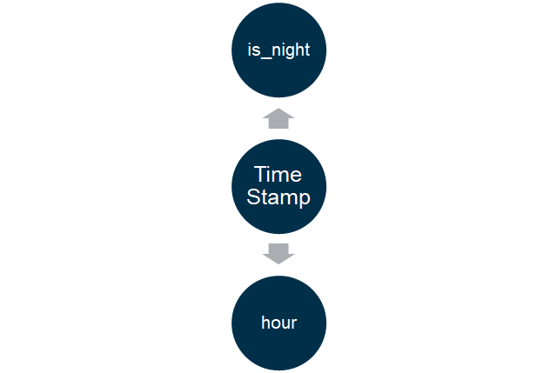
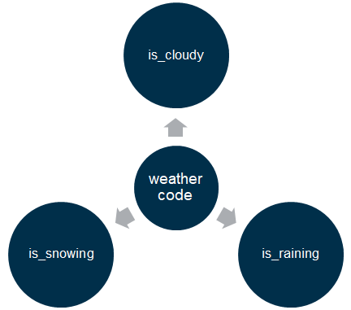
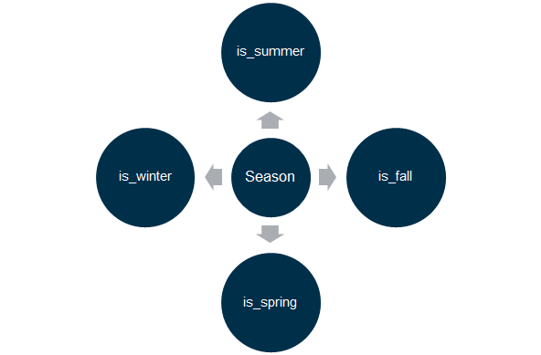
Categorical Attribute
STEVENS INSTITUTE OF TECHNOLOGY

Slide 13
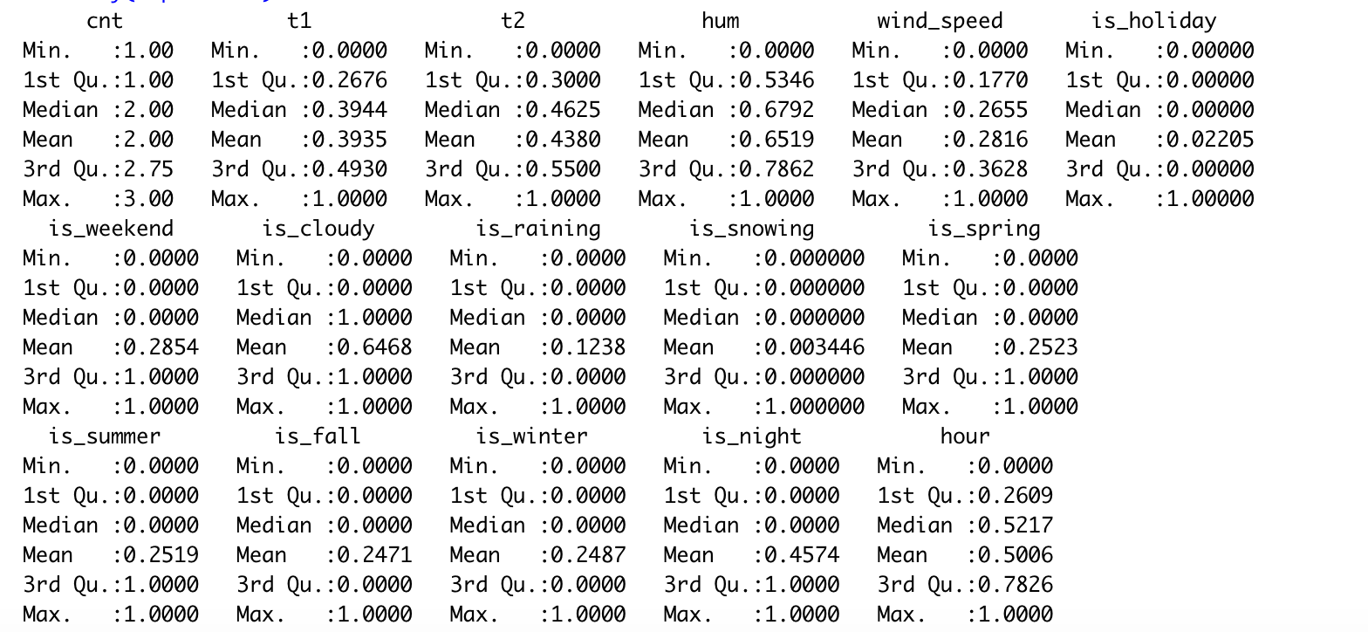
Processed Data Summary
STEVENS INSTITUTE OF TECHNOLOGY

Slide 14
Models
Clustering
Hierarchical Cluster
(KNN & XGBoost)
K-means
Classification
Dtree and C50
Random Forest
ANN
STEVENS INSTITUTE OF TECHNOLOGY

Slide 15
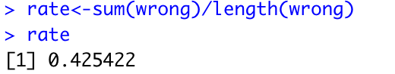
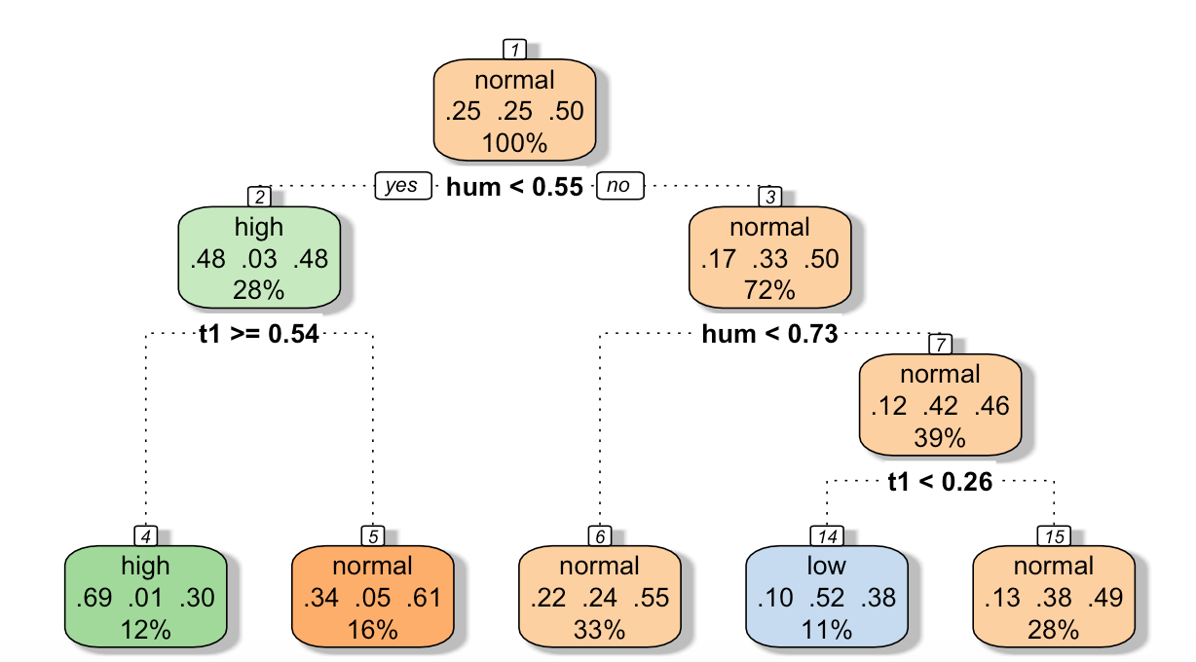
Decision Tree: CART and C5.0
This error rate is calculated by origin dataset. The attributes D-tree chose is not the main property of this dataset.
STEVENS INSTITUTE OF TECHNOLOGY

Slide 16
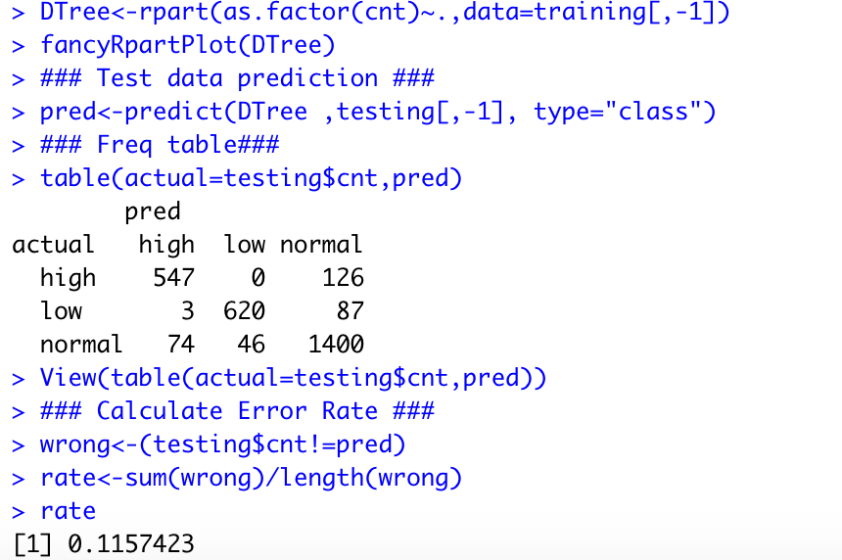
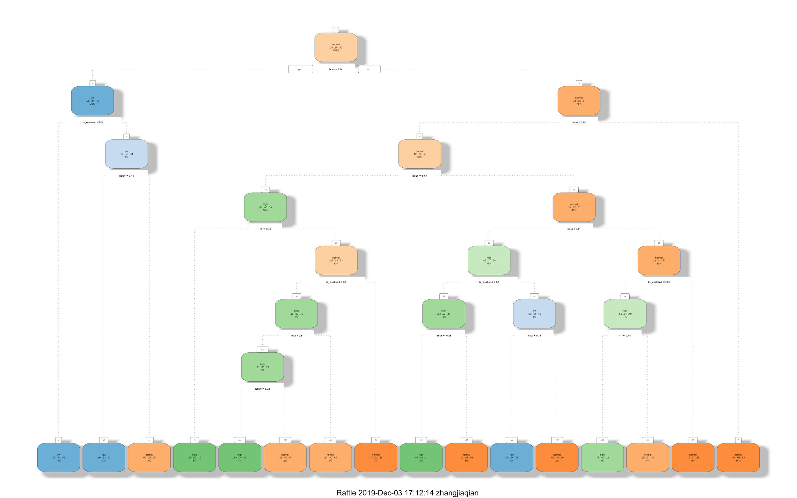
Decision Tree: CART and C5.0
CART
STEVENS INSTITUTE OF TECHNOLOGY

Slide 17
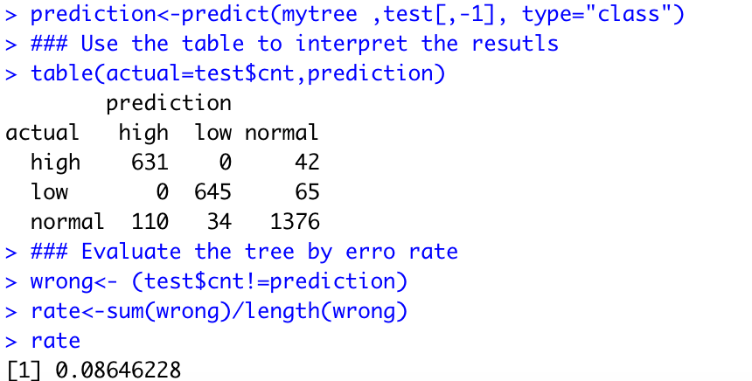
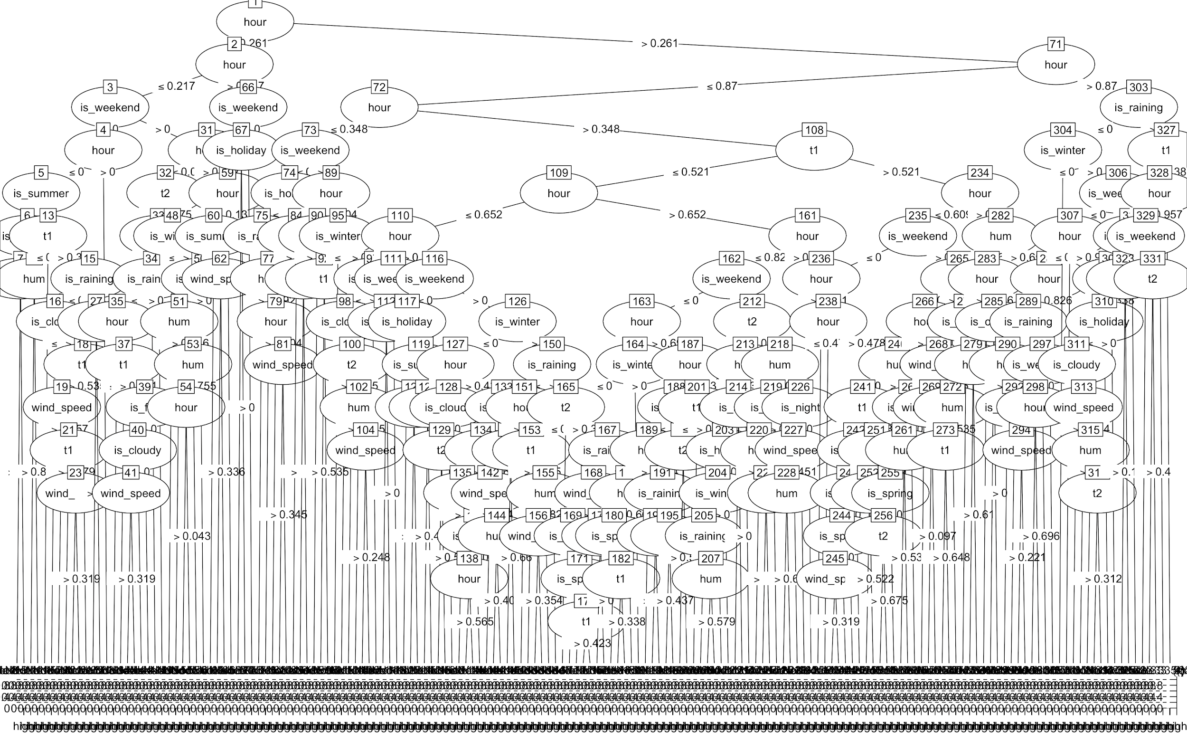
Decision Tree: CART and C5.0
C5.0
With data processed, the column Hour plays the decisive role to affect the weather.
STEVENS INSTITUTE OF TECHNOLOGY

Slide 18
Random Forest
Random Forest developed by aggregating trees.
Can be used for classification or regression.
User-friendly: only 2 free parameters
ntree – the number of trees, default 500
mtry -Variables randomly sampled as candidates at each split, default is sq.root(p) for classification & p/3 for regression.
STEVENS INSTITUTE OF TECHNOLOGY

Slide 19
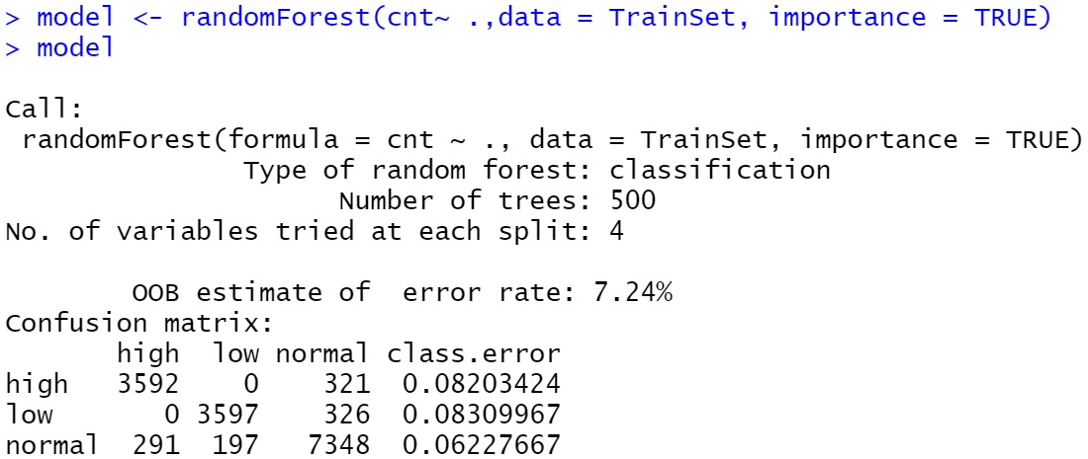
Build random Forest
# Create a Random Forest model with default parameters
> model <- randomForest(cnt~ .,data = TrainSet, importance = TRUE)
> model
STEVENS INSTITUTE OF TECHNOLOGY

Slide 20
Build random Forest
# Create a Random Forest model with default parameters
> model <- randomForest(cnt~ .,data = TrainSet, importance = TRUE)
> model
STEVENS INSTITUTE OF TECHNOLOGY

Slide 21
Build random Forest
# Create a Random Forest model with default parameters
> model <- randomForest(cnt~ .,data = TrainSet, importance = TRUE)
> model
STEVENS INSTITUTE OF TECHNOLOGY

Slide 22
Build random Forest
# Create a Random Forest model with default parameters
> model <- randomForest(cnt~ .,data = TrainSet, importance = TRUE)
> model
STEVENS INSTITUTE OF TECHNOLOGY

Slide 23
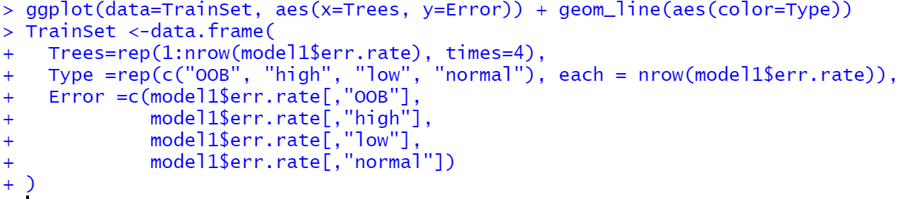
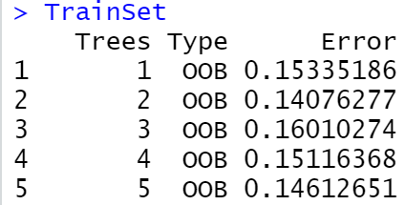
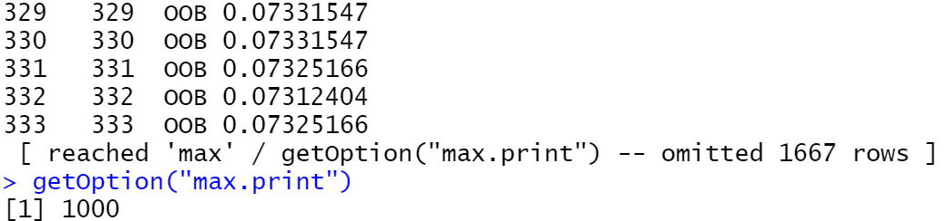
…
…
…
STEVENS INSTITUTE OF TECHNOLOGY

Slide 24
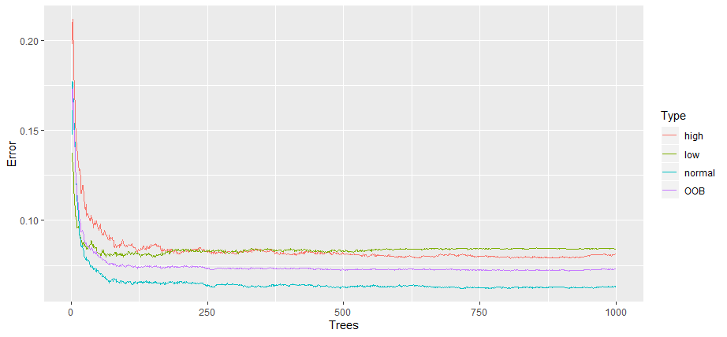
STEVENS INSTITUTE OF TECHNOLOGY

Slide 25
The error rates decrease when Random Forest has more trees.
STEVENS INSTITUTE OF TECHNOLOGY

Slide 26
The error rates decrease when Random Forest has more trees.
stabilize
STEVENS INSTITUTE OF TECHNOLOGY

Slide 27
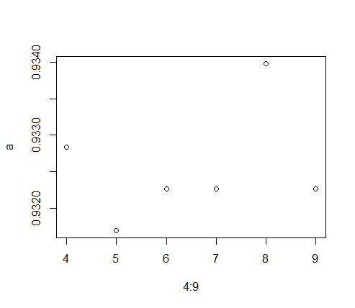
mtry
a=c()
i=6
for (i in 4:9) {
model2 <- randomForest(cnt ~ ., data = TrainSet, ntree = 1000, mtry = i, importance = TRUE)
predValid <- predict(model2, ValidSet, type = "class")
a[i-3] = mean(predValid == ValidSet$cnt)
}
a
plot(4:9,a)
mtry
[1] 0.9328358 0.9316877 0.9322618 0.9322618 0.9339839 0.9322618
STEVENS INSTITUTE OF TECHNOLOGY

Slide 28
mtry
a=c()
i=6
for (i in 4:9) {
model2 <- randomForest(cnt ~ ., data = TrainSet, ntree = 1000, mtry = i, importance = TRUE)
predValid <- predict(model2, ValidSet, type = "class")
a[i-3] = mean(predValid == ValidSet$cnt)
}
a
plot(4:9,a)
mtry
[1] 0.9328358 0.9316877 0.9322618 0.9322618 0.9339839 0.9322618
STEVENS INSTITUTE OF TECHNOLOGY

Slide 29
Important variables
# To check important variables
importance(model3)
varImpPlot(model3)
STEVENS INSTITUTE OF TECHNOLOGY

Slide 30
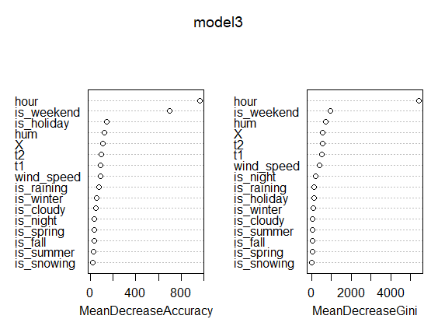
Important variables
# To check important variables
importance(model3)
varImpPlot(model3)
STEVENS INSTITUTE OF TECHNOLOGY

Slide 31
Test how worse the model performs without each variable
STEVENS INSTITUTE OF TECHNOLOGY

Slide 32
Test how worse the model performs without each variable
STEVENS INSTITUTE OF TECHNOLOGY

Slide 33
Test how worse the model performs without each variable
STEVENS INSTITUTE OF TECHNOLOGY

Slide 34
Test how worse the model performs without each variable
Measure how pure the nodes are at the end of the tree without each variable
STEVENS INSTITUTE OF TECHNOLOGY

Slide 35
Test how worse the model performs without each variable
Measure how pure the nodes are at the end of the tree without each variable
STEVENS INSTITUTE OF TECHNOLOGY

Slide 36

Random Forest
No Overfitting
Less training time
STEVENS INSTITUTE OF TECHNOLOGY

Slide 37

Random Forest
High accuracy
Runs efficiently in large data
No Overfitting
Less training time
STEVENS INSTITUTE OF TECHNOLOGY

Slide 38

Random Forest
Maintain accuracy
Estimates missing data
High accuracy
Runs efficiently in large data
No Overfitting
Less training time
STEVENS INSTITUTE OF TECHNOLOGY

Slide 39
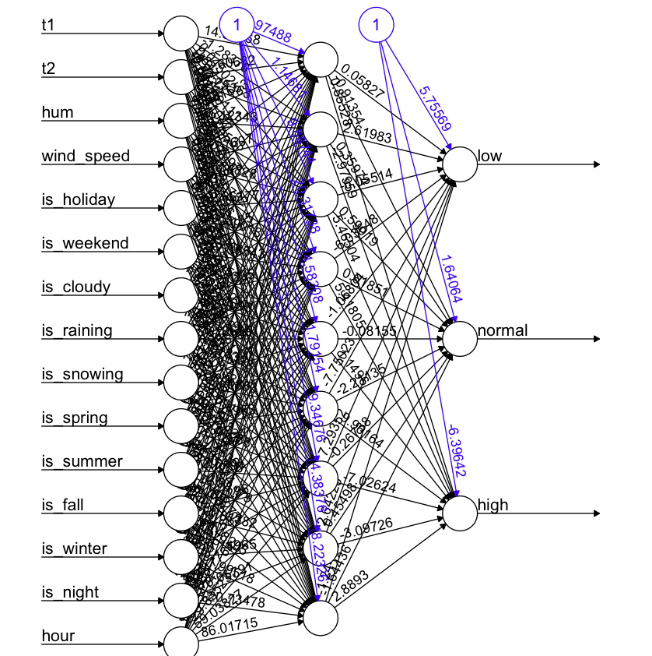
ANN
tree<-neuralnet( cnt~t1+t2+hum+wind_speed+is_holiday+is_weekend+is_cloudy+is_raining+is_snowing+is_spring+is_summer+is_fall+is_winter+is_night+hour, data=training,hidden = 9,stepmax = 5e+06, threshold = 0.01)
Accuracy: 0.9149156
STEVENS INSTITUTE OF TECHNOLOGY

Slide 40
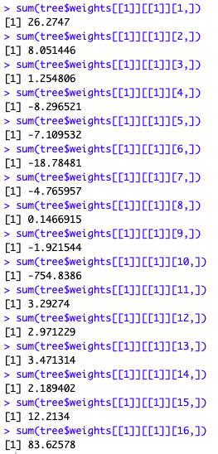
ANN weights
The least important one is the 10th element which is if_snowing.
The most important one is the 16the element which is time.
STEVENS INSTITUTE OF TECHNOLOGY

Slide 41
Clustering
K-means
Hierarchical Cluster
(KNN & XGBoost)
STEVENS INSTITUTE OF TECHNOLOGY

Slide 42
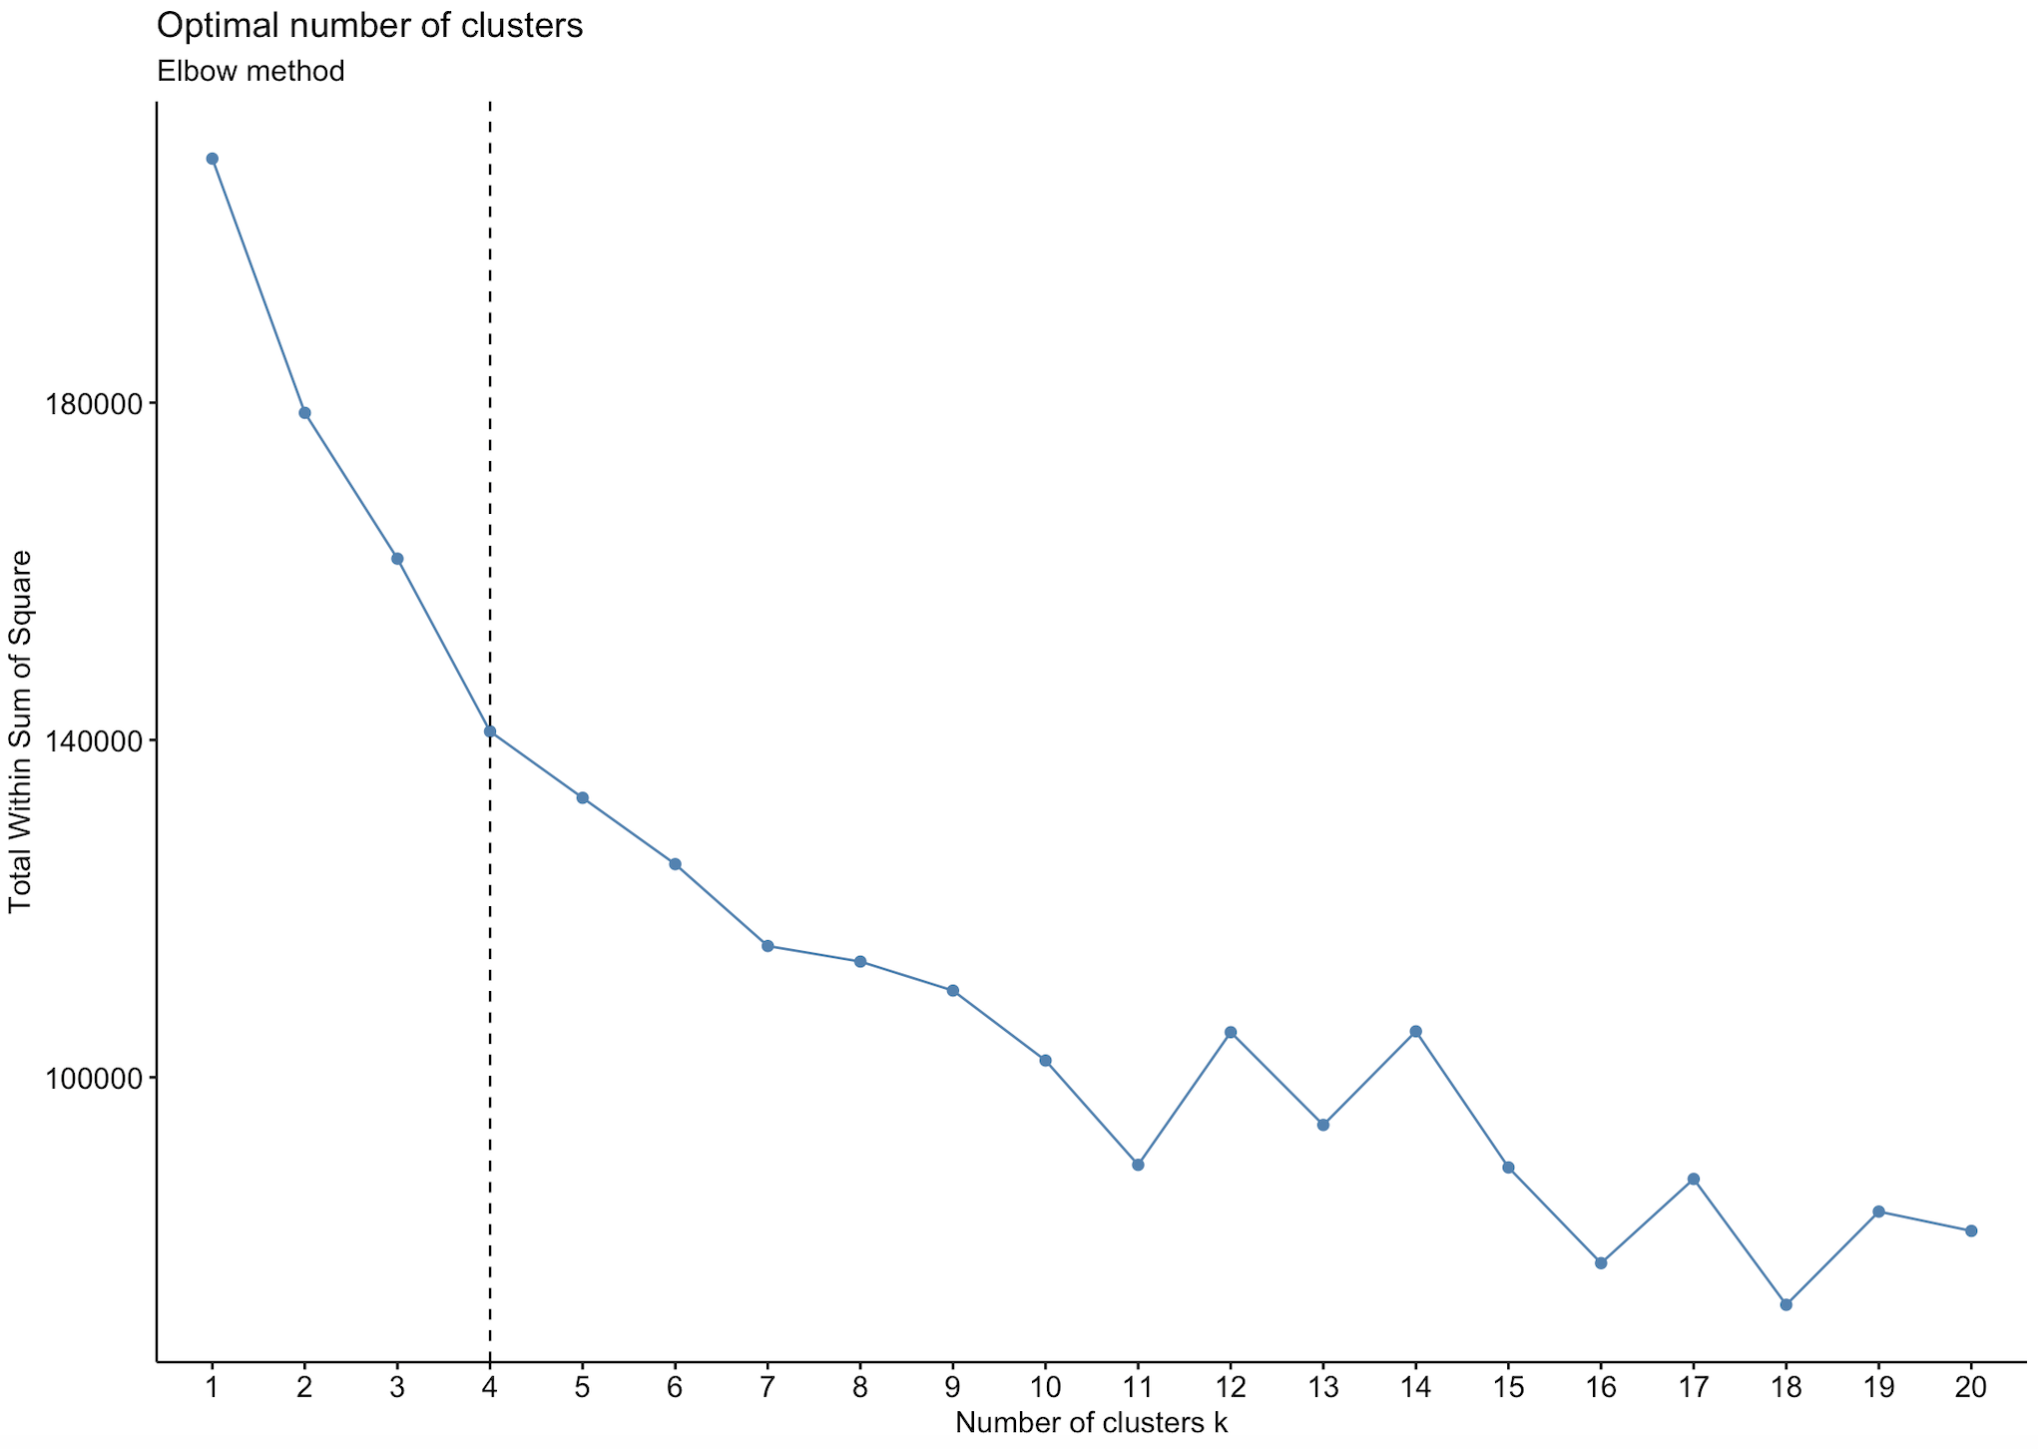
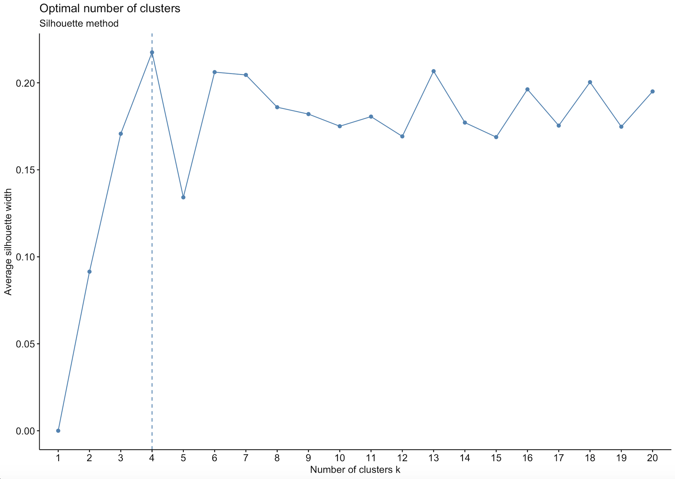
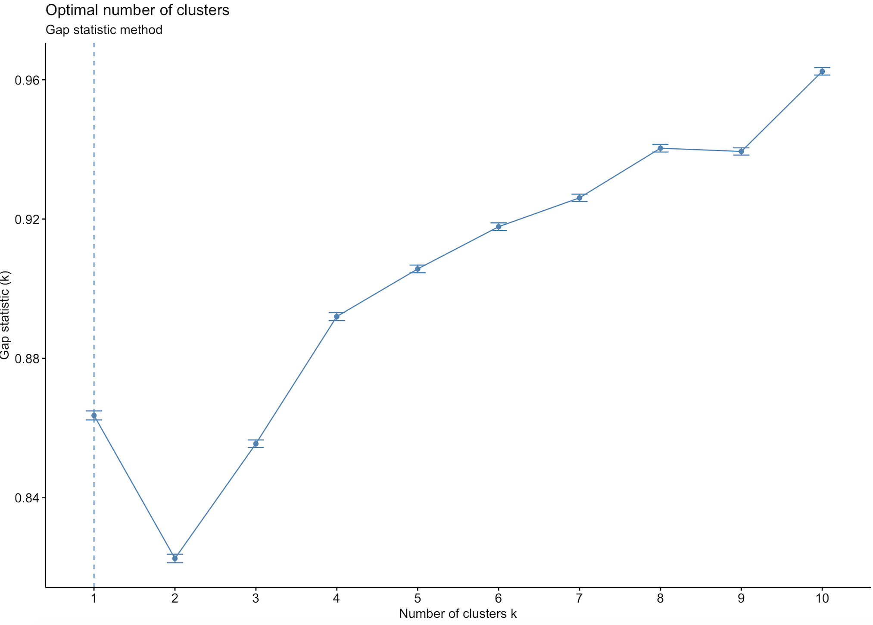
Kmeans Cluster
Approaches to choose K

Slide 43
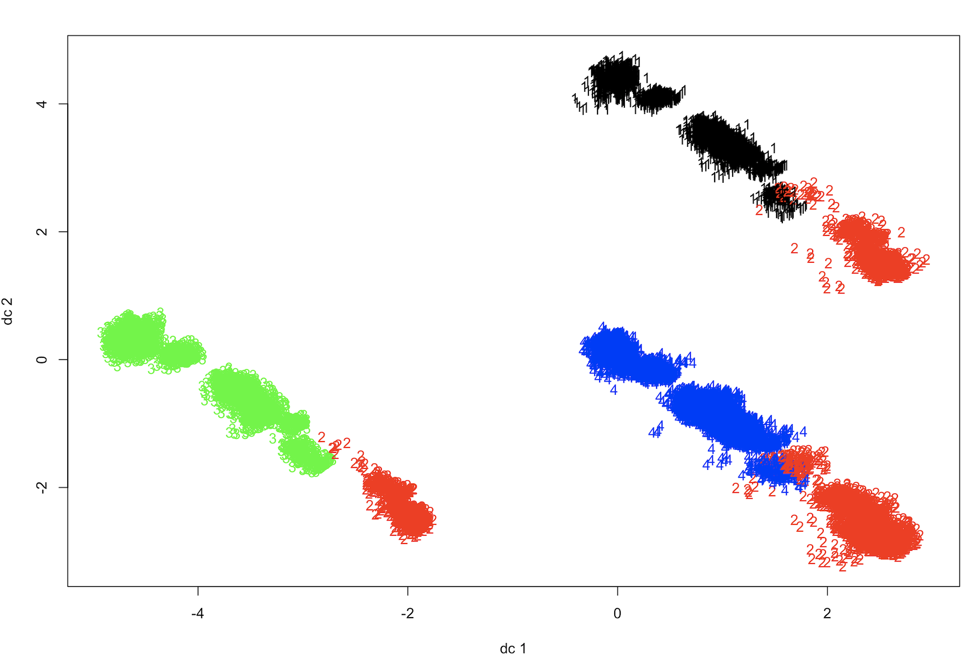
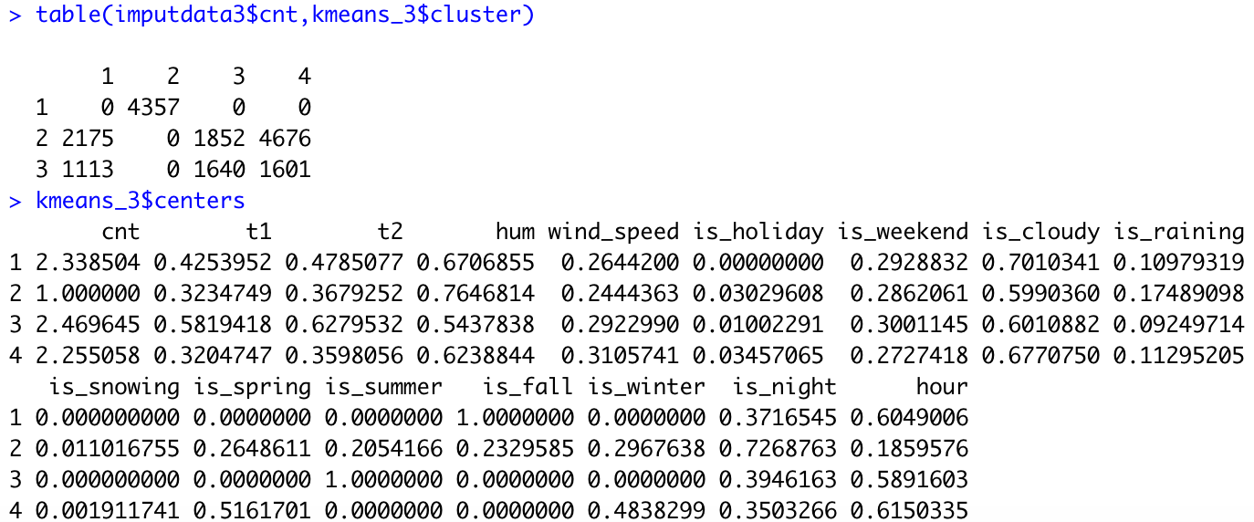
Kmeans Cluster
predict.kmeans <- function(object, newdata){
centers <- object$centers
n_centers <- nrow(centers)
dist_mat <- as.matrix(dist(rbind(centers, newdata)))
dist_mat <- dist_mat[-seq(n_centers), seq(n_centers)]
max.col(-dist_mat)
}
STEVENS INSTITUTE OF TECHNOLOGY

Slide 44
Hclust Method
Method: "ward.D2", "single", "complete", "average" , "mcquitty" , "median" or "centroid" .
library(factoextra)
library(NbClust)
com <- hcut(d,k=3,hc_method = "complete")
fviz_cluster(com,Data)
com_tree <- cutree(com,k = 3)
com_data <- creat_new_data(Data,com_tree,True_Class)
com_list <- knn_model_creation(com_data,dir)
error_rate_complete <- 1 - as.numeric(com_list[2])
complete_k <- as.numeric(com_list[3])
STEVENS INSTITUTE OF TECHNOLOGY

Slide 45
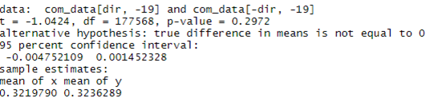
knn_model_creation <- function(Data,dir) { max_accuracy <- 0 True_Class <- Data[-dir,19] i <- 1 for(i in 1:100) { model <- knn(train = Data[dir,-19], test = Data[-dir,-19], cl = Data[dir,19], k = i) cm <- table(factor(x = True_Class, levels = c("low","normal","high")),model) accuracy <- sum(diag(cm))/length(Data[-dir,19]) if(accuracy > max_accuracy) { max_model <- model max_accuracy <- accuracy k <- i } } model_accur_k <- list(max_model,max_accuracy,k) return(model_accur_k) }
KNN
STEVENS INSTITUTE OF TECHNOLOGY

Slide 46
Result
Error rate ward | Ward k | Error rate average | Average k | Error rate centroid | Centroid k | Error rate complete
0.176268 | 3 | 0.176459 | 3 | 0.174545 | 3 | 0.176651
Complete k | Error rate mcquitty | Mcquitty k | Error rate single | Single k | Error rate knn | Knn k
3 | 0.176268 | 3 | 0.176842 | 3 | 0.176459 | 3
STEVENS INSTITUTE OF TECHNOLOGY

Slide 47
XGboost Method
Model <- xgboost(data = data.matrix(Train_Data), label = Train_Class, eta = 0.01, max_depth = 14, nround=50, subsample = 0.75, colsample_bytree = 1, seed = 1, eval_metric = "mlogloss", objective = "multi:softprob", nthread = 3, num_class = 3)
STEVENS INSTITUTE OF TECHNOLOGY

Slide 48
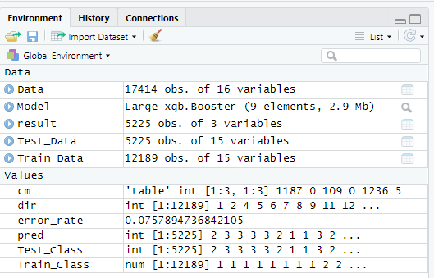
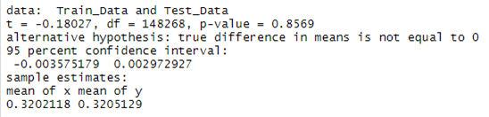
The error rate is 7.57%
STEVENS INSTITUTE OF TECHNOLOGY

Slide 49
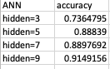
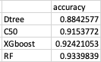
Conclusion
RF and XGboost are the two perfect algorithms for this data.
From ANN,Dtree and Random Forest, we can find out that timing plays a very important role in predicting london bike uses.
STEVENS INSTITUTE OF TECHNOLOGY

Slide 50
Reference
Data Source：https://www.kaggle.com/hmavrodiev/london-bike-sharing-dataset
End
Thank you
STEVENS INSTITUTE OF TECHNOLOGY

